Slide 1
Excelling with EXCEL
Day 1: R Workshop

Slide 2
DATA MANAGEMENT
In our digital world, data pours into organizations from many sources –
Scanners, sensors – lab devices etc.
Smart devices – Phones, TVs, etc.
Social media – Twitter, Facebook, YouTube, etc.
Video
Texts
Managing data effectively requires having a data strategy and reliable methods to access, integrate, cleanse, store and prepare data for analytics.
The value of data depends on what you do with it

Slide 3
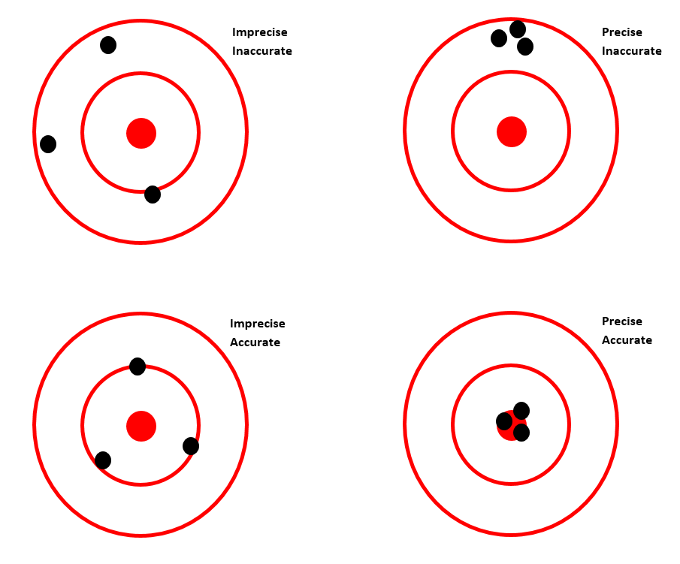
WHAT YOU MEASURE AND HOW
aCcuracy = Correct. Are the measurements correct on average?
pRecision = reproducible, repeatable. When you measure the same item multiple times, do you get similar values?
Systematically off target!
Standard or true value
Measured values
Points average out to be on target
Points on target on average and are close together

Slide 4
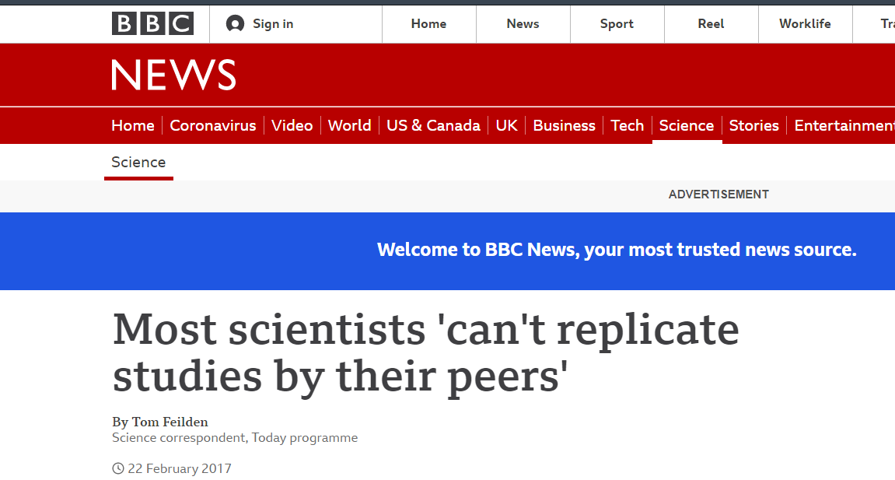
“REPRODUCIBILITY CRISIS”
Up to 2/3 of researchers have tried and failed to reproduce another scientist’s experiments
"Replication is something scientists should be thinking about before they write the paper" - Ritu Dhand, Editorial director at Nature.

Slide 5






RIGHT TOOL FOR THE TRADE

Slide 6

IMPORTANT!
Choose the appropriate experimental design
Choose the right tool for the trade
Think out of the box
are there smarter ways to process,
analyze and
visualize your data?
Document your analyses
Break data analysis to steps
Break codes to snippets

Slide 7
STARTER PACK: MICROSOFT EXCEL
Get you data in shape - Use a template for data entry/collection
Use short, but descriptive sheet and variable names. No spaces or special characters
No graphs on data sheet - copy data to a new sheet for graphing
No formulae on data sheet

Slide 8
TASKS FOR TODAY
- FIRST THINGS FIRST (Excelling with MS Excel)
- What's EXCEL to you?
- Rules, rules, and rules for spreadsheets!
> Data WRANGLING
- Year and month from date column
- Merging multiple sheets (XLXS) and files (XLXS/CSV)
- Wide data to long DATA
- Grabbing data from the web.

Slide 9
TASKS FOR TODAY
> MACROs
- Year and month from date column
- COVID Death map with a click
- World Population map with a click
- Exercise: Create your macros.

Slide 10
